Slide 1

CHAPTER 14
Derivation of State Graphs and Tables
This chapter in the book includes:
Objectives
Study Guide
14.1 Design of a Sequence Detector
14.2 More Complex Design Problems
14.3 Guidelines for Construction of State Graphs
14.4 Serial Data Code Conversion
14.5 Alphanumeric State Graph Notation
Programmed Exercises
Problems

Slide 2
Objectives
Given a problem statement for the design of a Mealy or Moore
sequential circuit, find the corresponding state graph and table.
2. Explain the significance of each state in your graph or table
in terms of the input sequences required to reach that state.
3. Check your state graph using appropriate input sequences.

Slide 3
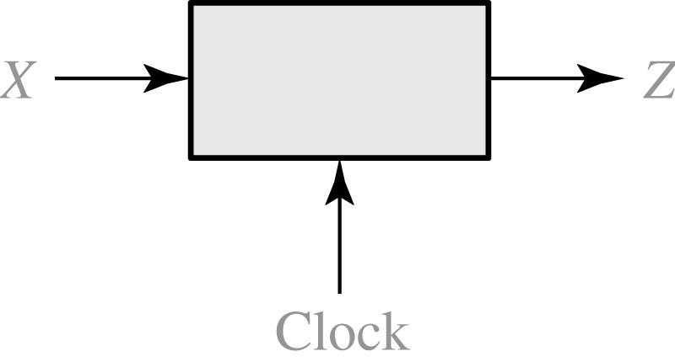
14.1 Design of a Sequence Detector
Fig 14.1 Sequence Detector to be Designed
X = | 0 | 0 | 1 | 1 | 0 | 1 | 1 | 0 | 0 | 1 | 0 | 1 | 0 | 1 | 0 | 0
Z = | 0 | 0 | 0 | 0 | 0 | 1 | 0 | 0 | 0 | 0 | 0 | 1 | 0 | 1 | 0 | 0
(time: | 0 | 1 | 2 | 3 | 4 | 5 | 6 | 7 | 8 | 9 | 10 | 11 | 12 | 13 | 14 | 15)

Slide 4
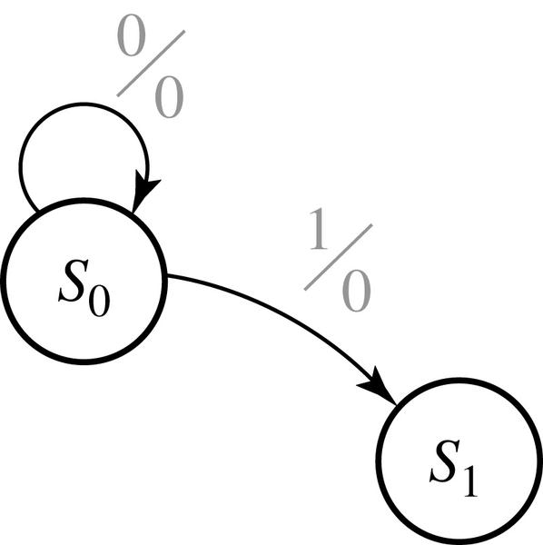
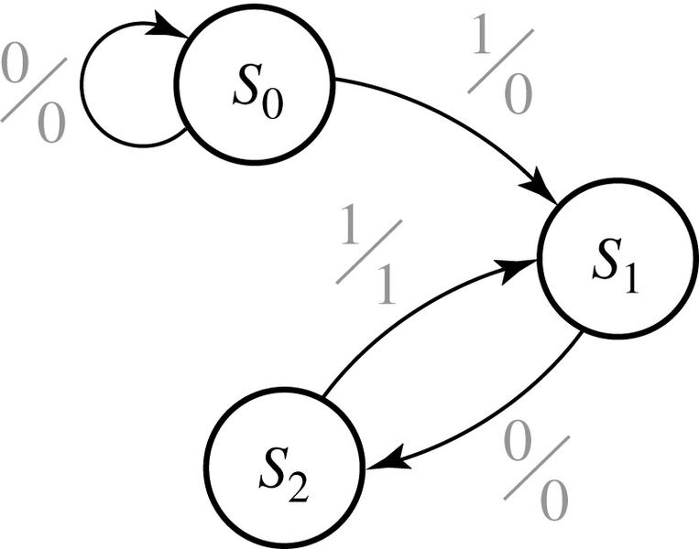
14.1 Design of a Sequence Detector
Fig 14.2 and 14.3 : Formation of State Graph

Slide 5
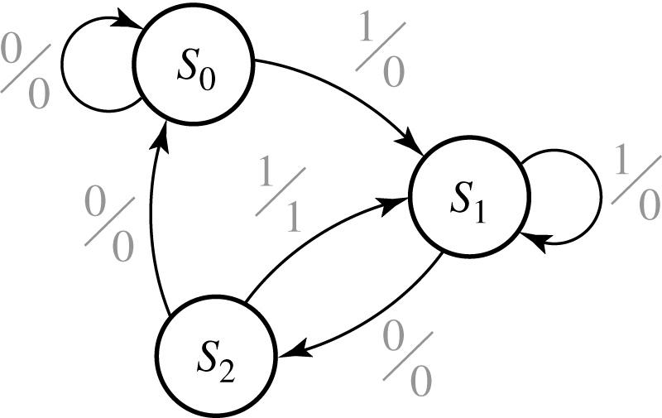
14.1 Design of a Sequence Detector
Fig 14.4 Mealy State Graph for Sequence Detector

Slide 6
14.1 Design of a Sequence Detector
Table 14-1, State Table
Present state |  | Next State |  | Present Output
 |  | X = 0 | X = 1 | X = 0 | X =1
S₀ S₁ S₂ |  | S₀ S₂ S₀ | S₀ S₁ S₁ | 0 0 0 | 0 0 1
Table 14-2, Transition Table with State Assignment
AB |  | A⁺ B⁺ |  | Z
 |  | X = 0 | X = 1 | X = 0 | X =1
00 01 10 |  | 00 10 00 | 01 01 01 | 0 0 0 | 0 0 1

Slide 7
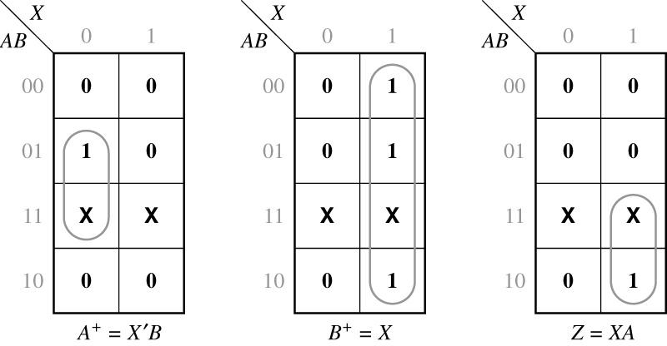
14.1 Design of a Sequence Detector
Map for the output function Z (from table 1,2)

Slide 8
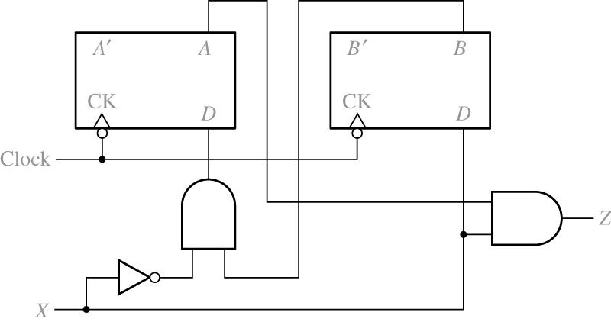
14.1 Design of a Sequence Detector
Fig 14.5: Final Circuit

Slide 9
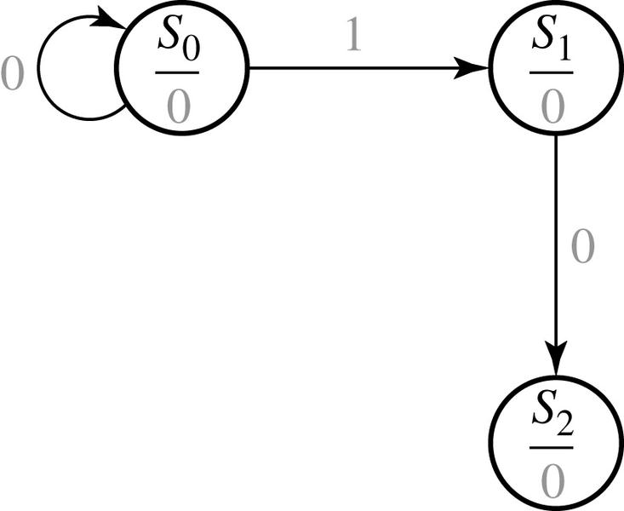
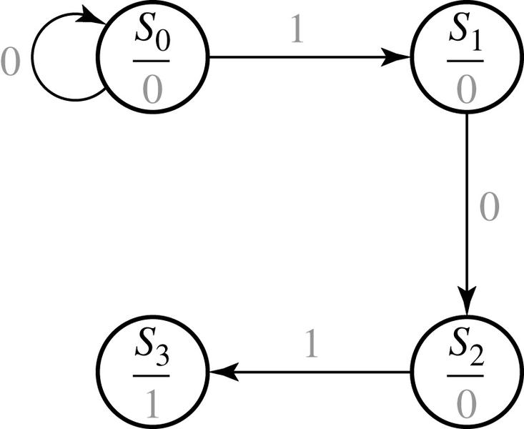
14.1 Design of a Sequence Detector
Moore Machine Design Process

Slide 10
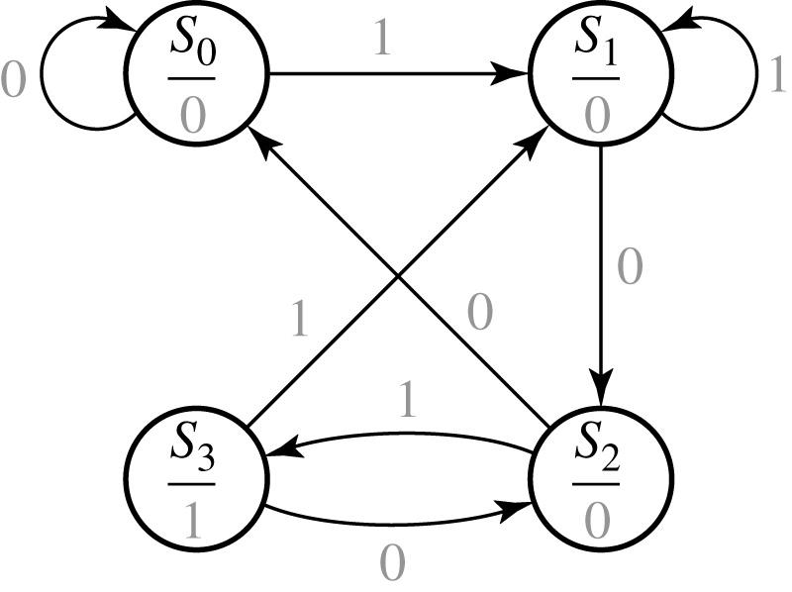
14.1 Design of a Sequence Detector
Fig 14.6 Moore State Graph for Sequence Detector

Slide 11
14.1 Design of a Sequence Detector
Table 14-3 State Table
Table 14-4 Transition Table with State assignment
Present state |  | Next State |  | Present Output (Z)
 |  | X = 0 | X = 1
S₀ S₁ S₂ S₃ |  | S₀ S₂ S₀ S₂ | S₁ S₁ S₃ S₁ | 0 0 0 1
AB |  | A⁺ B⁺ |  | Z
 |  | X = 0 | X = 1
00 01 11 10 |  | 00 11 00 11 | 01 01 10 01 | 0 0 0 1

Slide 12
14.2 More Complex Design Problems
The circuit to be designed (Mealy)
Output Z=1 if input sequence ends in either 010 or 1001
X= | 0 | 0 | 1 | 0 | 1 | 0 | 0 | 1 | 0 | 0 | 0 | 1 | 0 | 0 | 1 | 1 | 0
 |  |  |  | ↑ |  | ↑ |  | ↑ | ↑ |  |  |  | ↑ |  | ↑
 |  |  |  | a |  | b |  | c | d |  |  |  | e |  | f
Z= | 0 | 0 | 0 | 1 | 0 | 1 | 0 | 1 | 1 | 0 | 0 | 0 | 1 | 0 | 1 | 0 | 0

Slide 13
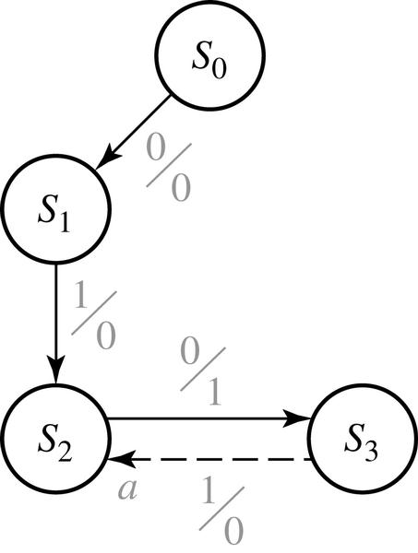
14.2 More Complex Design Problems
Fig 14.7 formation of state graph ( step1 )
state | sequence received
S₀ S₁ S₂ S₃ | reset 0 01 010

Slide 14
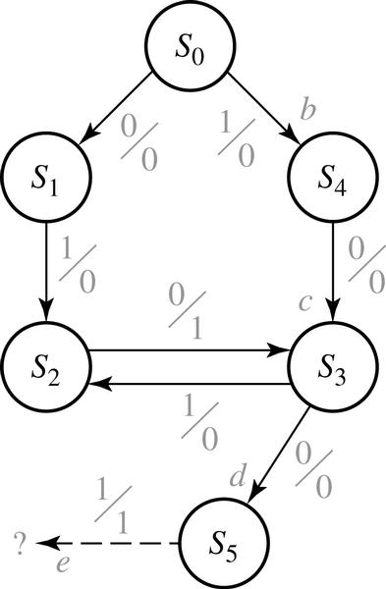
14.2 More Complex Design Problems
Fig 14.8 formation of state graph ( step2 )
state | sequence ends in
S₀ S₁ S₂ S₃ S₄ S₅ | reset 0 (but not 10) 01 10 1 (but not 01) 100

Slide 15
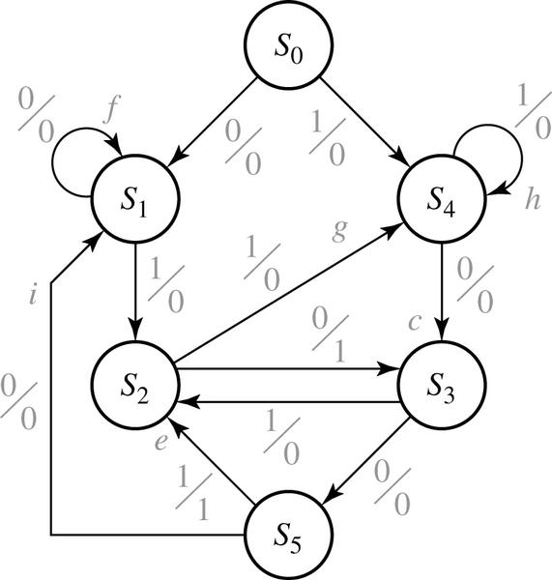
14.2 More Complex Design Problems
Fig 14.9 Completed State Graph for a Sequence Detector to be Designed
state | sequence ends in
S₀ S₁ S₂ S₃ S₄ S₅ | reset 0 (but not 10) 01 10 1 (but not 01) 100

Slide 16
14.2 More Complex Design Problems
The circuit to be designed (Moore)
Output Z=1 if the total number of 1’s received is odd and at least two consecutive 0’s have been received
X= | 1 | 0 | 1 | 1 | 0 | 0 | 1 | 1
 | ↑ |  |  | ↑ |  | ↑ | ↑ | ↑
 | a |  |  | b |  | c | d | e
Z= | (0) | 0 | 0 | 0 | 0 | 1 | 0 | 1

Slide 17
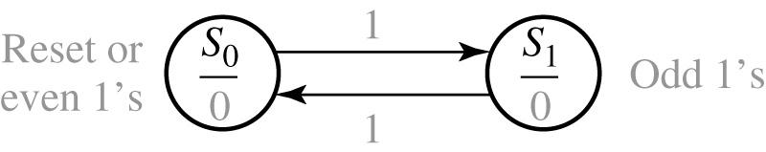
14.2 More Complex Design Problems
Fig 14.10 formation of state graph ( step1)

Slide 18
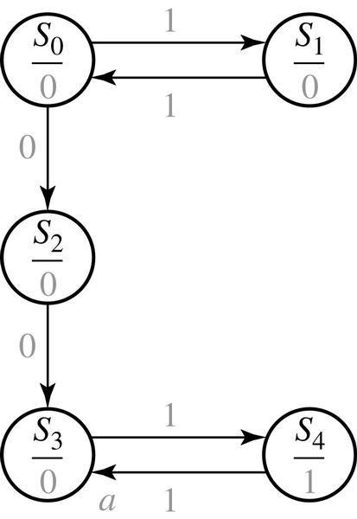
14.2 More Complex Design Problems
Fig 14.11 formation of state graph ( step2 )
state | sequence ends in
S₀ S₁ S₂ S₃ S₄ | reset or even 1’s odd 1’s even 1’s and ends in 0 even 1’s and 00 has occurred 00 has occurred and odd 1’s

Slide 19
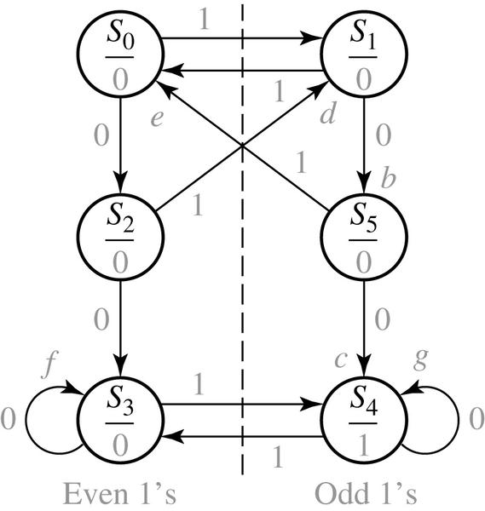
14.2 More Complex Design Problems
Fig 14.12 Completed State Graph for a Sequence Detector to be Designed
state | sequence ends in
S₀ S₁ S₂ S₃ S₄ S₅ | reset or even 1’s odd 1’s even 1’s and ends in 0 even 1’s and 00 has occurred odd 1’s and 00 has occurred odd 1’s and ends in 0

Slide 20
14.3 Guidelines for Construction of State Graphs
Construct some sample input and output sequences to make sure that you understand
the problem statement.
2. Determine under what conditions the circuit should reset to its initial state.
3. If only one or two sequences lead to a non-zero output, a good way to start is to construct
a partial state graph for those sequences.
4. Determine what sequences or groups of sequences must be remembered by the circuit and
set up states accordingly.
5. Each time you add an arrow to the state graph, determine it can go to one of the previously
defined states or whether a new state must be added
6. Check your state graph to make sure there is one and only one path leaving each state
for each combination of values of the input variables
7. When your state graph is complete, test it by applying the input sequences formulated in part1
and making sure the output sequences are correct

Slide 21
14.3 Guidelines for Construction of State Graphs
Example 1 : Z=1 when input sequence 0101 or 101 occurs.
The circuit resets after every four inputs. Mealy Circuit
A typical sequence of input and output
X = | 0101 | 0010 | 1001 | 0100
Z = | 0001 | 0000 | 0001 | 0000

Slide 22
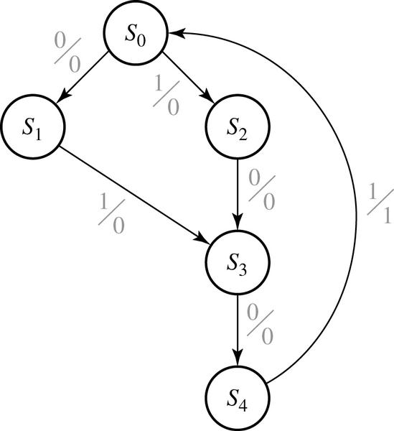
14.3 Guidelines for Construction of State Graphs
Fig 14.13 Partial State Graph for Example 1
state | sequence received
S₀ S₁ S₂ S₃ S₄ | Reset 0 1 01 or 10 010 or 100

Slide 23
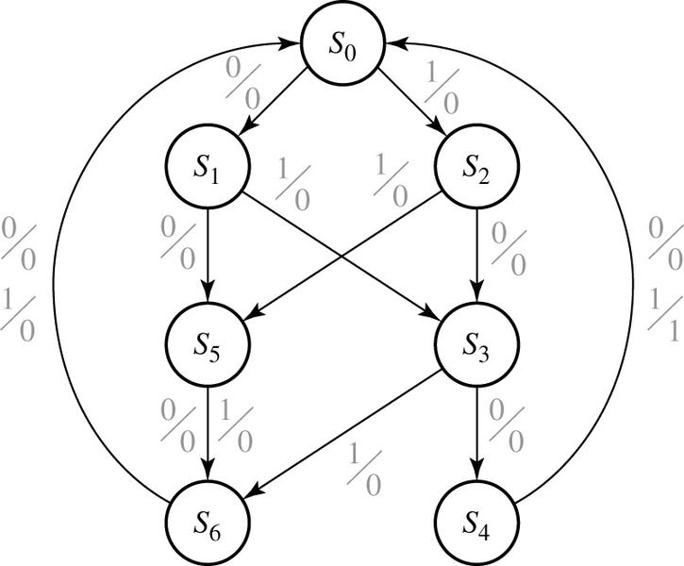
14.3 Guidelines for Construction of State Graphs
Fig 14.14 Complete State Graph for Example 1
state | sequence received
S₀ S₁ S₂ S₃ S₄ S₅ S₆ | Reset 0 1 01 or 10 010 or 100 two inputs received, no 1 output is possible three inputs received, no 1 output is possible

Slide 24
14.3 Guidelines for Construction of State Graphs
Example 2 : Z1=1 every time the input sequence 100 is completed
Z2=1 every time the input sequence 010 is completed
Once Z2=1 occurred, Z1=1 can never occur but not vice versa
Mealy circuit
A typical sequence of input and output
X | = | 1 | 0 | 0 | 1 | 1 | 0 | 0 | 1 | 0 | 1 | 0 | 1 | 0 | 0 | 1 | 0 | 1 | 1 | 0 | 1 | 0 | 0
Z₁ | = | 0 | 0 | 1 | 0 | 0 | 0 | 1 | 0 | 0 | 0 | 0 | 0 | 0 | 0 | 0 | 0 | 0 | 0 | 0 | 0 | 0 | 0
Z₂ | = | 0 | 0 | 0 | 0 | 0 | 0 | 0 | 0 | 1 | 0 | 1 | 0 | 1 | 0 | 0 | 1 | 0 | 0 | 0 | 0 | 1 | 0

Slide 25
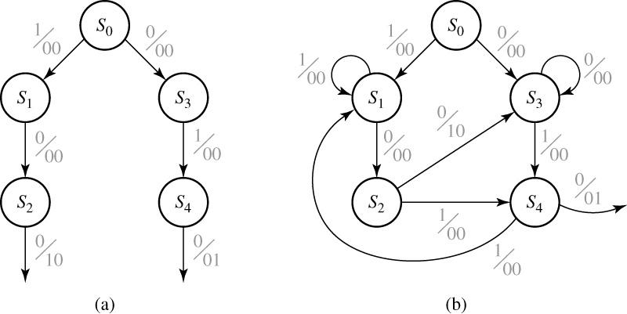
14.3 Guidelines for Construction of State Graphs
Fig 14.15 Partial Graphs for Example 2

Slide 26
14.3 Guidelines for Construction of State Graphs
Table 14-5 State Descriptions for Example 2
stats | Description
S₀ S₁ S₂ S₃ S₄ | No progress on 100 Progress of 1 on 100 Progress of 10 on 100 No progress on 100 Progress of 10 on 100 | No progress on 010 No progress on 010 Progress of 0 on 010 Progress of 0 on 010 Progress of 01 on 010 | 010 has never occurred
S₅ S₆ S₇ |  | Progress of 0 on 010 Progress of 01 on 010 No progress on 010 | 010 has occurred

Slide 27
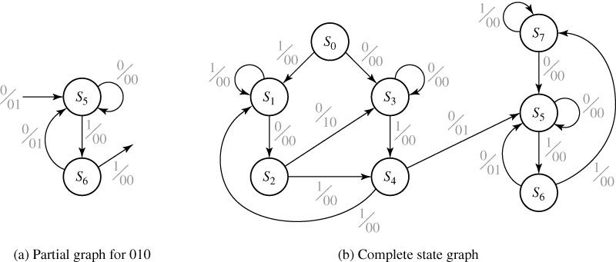
14.3 Guidelines for Construction of State Graphs
Fig 14.16 State Graphs for Example 2

Slide 28
14.3 Guidelines for Construction of State Graphs
Table 14-6
Present state |  | Next X = 0 | State X = 1 |  | Output X = 0 | (Z₁ Z₂) X = 1
S₀ S₁ S₂ S₃ S₄ S₅ S₆ S₇ |  | S₃ S₂ S₃ S₃ S₅ S₅ S₅ S₅ | S₁ S₁ S₄ S₄ S₁ S₆ S₇ S₇ |  | 00 00 10 00 01 00 01 00 | 00 00 00 00 00 00 00 00

Slide 29
14.3 Guidelines for Construction of State Graphs
Example 3: Two inputs – X1, X2, One output – Z
(a) The input sequence X1X2=01, 11 cause the output 0
(b) The input sequence X1X2=10, 11 cause the output 1
(c) The input sequence X1X2=10, 01 cause the output to change
Previous Input (X₁X₂) | Output (Z) | State Designation
00 or 11 00 or 11 01 01 10 10 | 0 1 0 1 0 1 | S₀ S₁ S₂ S₃ S₄ S₅

Slide 30
14.3 Guidelines for Construction of State Graphs
Table 14-7
Present |  | Z |  |  | Next state
State |  |  | X₁X₂ | = | 00 | 01 | 11 | 10
S₀ S₁ S₂ S₃ S₄ S₅ |  | 0 1 0 1 0 1 |  |  | S₀ S₁ S₀ S₁ S₀ S₁ | S₂ S₃ S₂ S₃ S₃ S₂ | S₀ S₁ S₀ S₀ S₁ S₁ | S₄ S₅ S₄ S₅ S₄ S₅

Slide 31
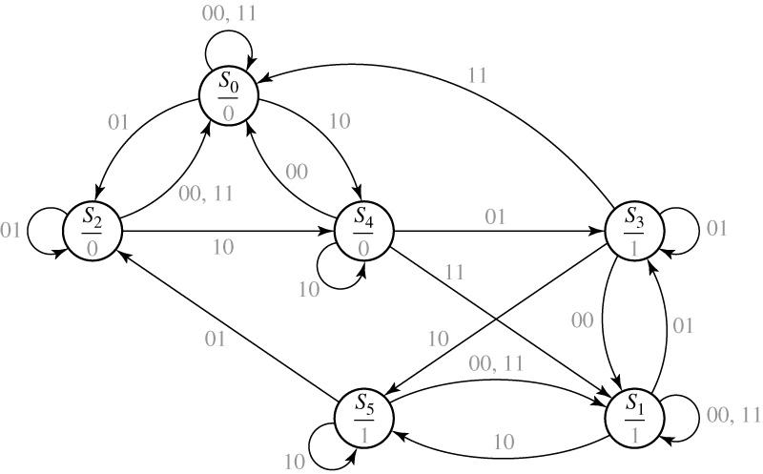
14.3 Guidelines for Construction of State Graphs
Fig 14-17 State Graph for Example 3

Slide 32
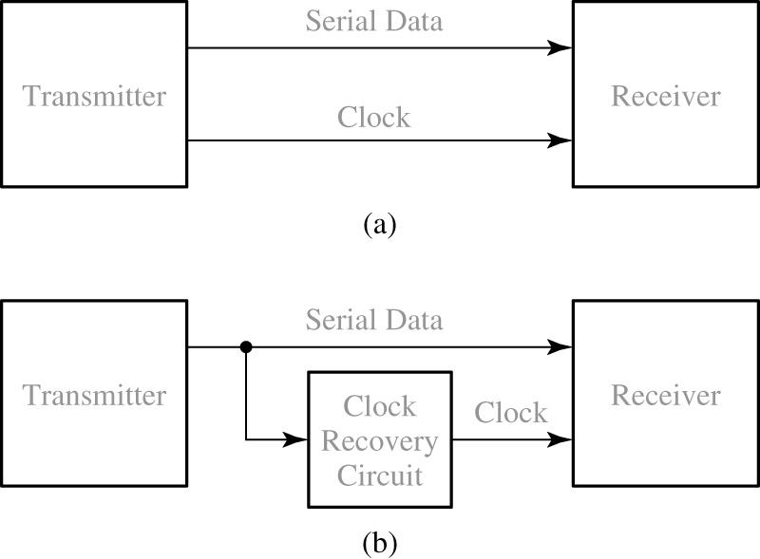
14.4 Serial Data Code Conversion
Fig 14.18 Serial Data Transmission

Slide 33
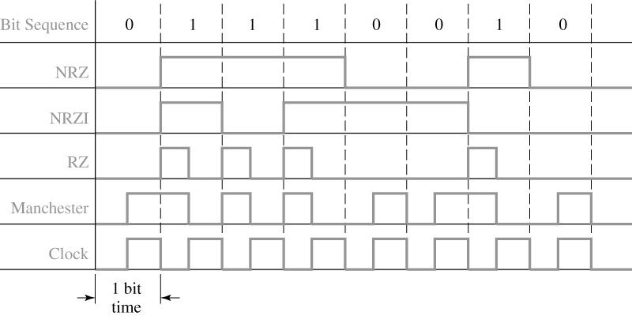
14.4 Serial Data Code Conversion
Fig 14.19 Coding Schemes for Serial Data Transmission

Slide 34
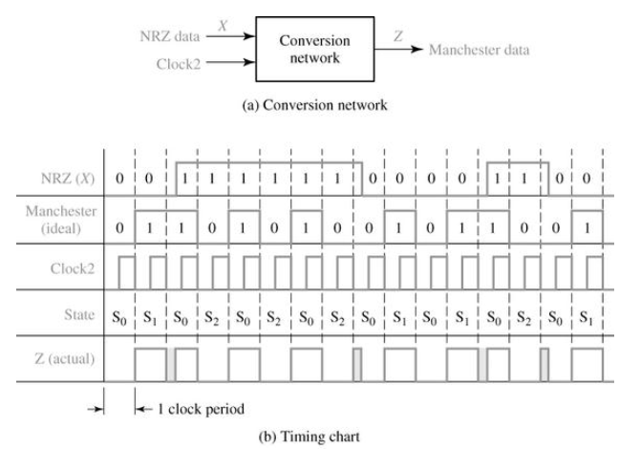
14.4 Serial Data Code Conversion
Fig 14.20 Mealy circuit for NRZ to Manchester Conversion

Slide 35
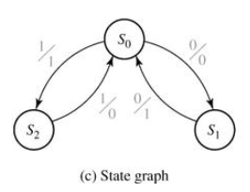
14.4 Serial Data Code Conversion
Fig 14.20 Sequence Detector to be Designed
Present |  | Next State |  |  | Output (Z)
State |  | X = 0 |  | X = 1 | X = 0 |  | X = 1
S₀ S₀ S₀ |  | S₀ S₀ - |  | S₀ - S₀ | 0 1 - |  | 1 - 0
(d) State table

Slide 36
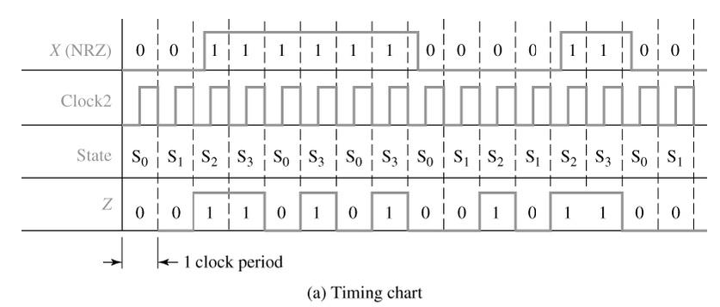
14.4 Serial Data Code Conversion
Fig 14.21 Moore Circuit for NRZ-to-Manchester Conversion

Slide 37
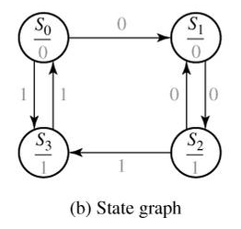
14.4 Serial Data Code Conversion
Fig 14.21 Moore Circuit for NRZ-to-Manchester Conversion
Present |  | Next State |  |  | Present
State |  | X = 0 |  | X = 1 | Output (Z)
S₀ S₁ S₂ S₃ |  | S₁ S₂ S₁ - |  | S₃ - S₃ S₀ | 0 0 1 1
(c) State table

Slide 38
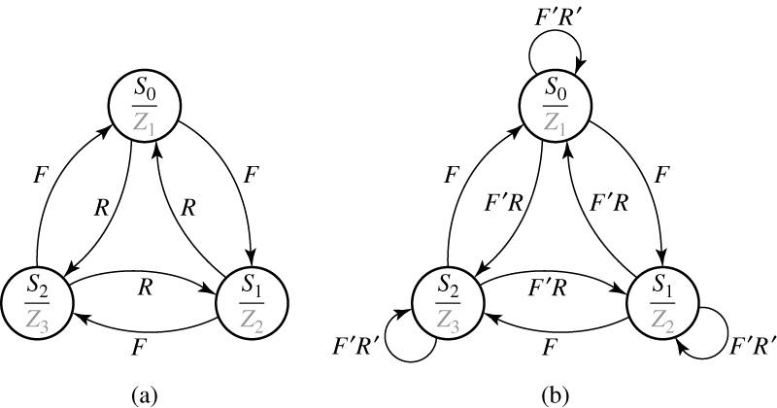
14.5 Alphanumeric State Graph Notation
Fig 14.22 State Graphs with Variable Names on Arc Labels

Slide 39
14.5 Alphanumeric State Graph Notation
Table 14-8 State Table for Fig 14-22
PS | NS |  |  |  |  | Output
 | FR = | 00 | 01 | 10 | 11 | Z₁ | Z₂ | Z₃
S₀ S₀ S₀ |  | S₀ S₀ S₀ | S₀ S₀ S₀ | S₀ S₀ S₀ | S₀ S₀ S₀ | 1 0 0 | 0 1 0 | 0 0 1
The result :
If we AND together every possible pair of arc labels emanating from S₀, we get

Slide 40
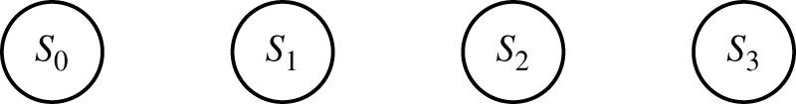
14. Programmed Exercises 14.1
Add arrows to the following graph so that the sequence X = 010
gives the correct output (do not add another state)

Slide 41
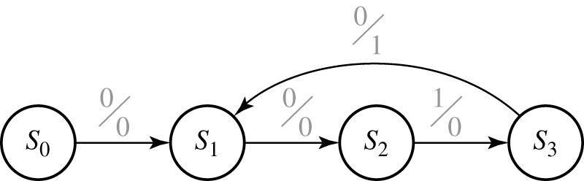
14. Programmed Exercises 14.1
State | Sequence received
S₀ S₁ S₂ S₃ S₄ | (reset) 0 or 0010
Note that the arrow from S₃ returns to S₁ so that
an additional input of 010 will produce another 1 output.

Slide 42
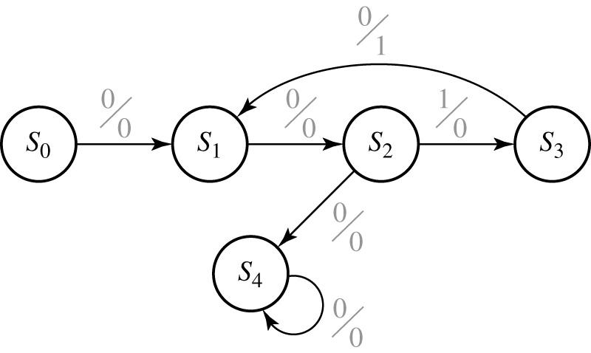
14. Programmed Exercises 14.1
State | Sequence received
S₀ S₁ S₂ S₃ S₄ | (reset) 0 or 0010 00 001 3 (or more) consec 0’s

Slide 43
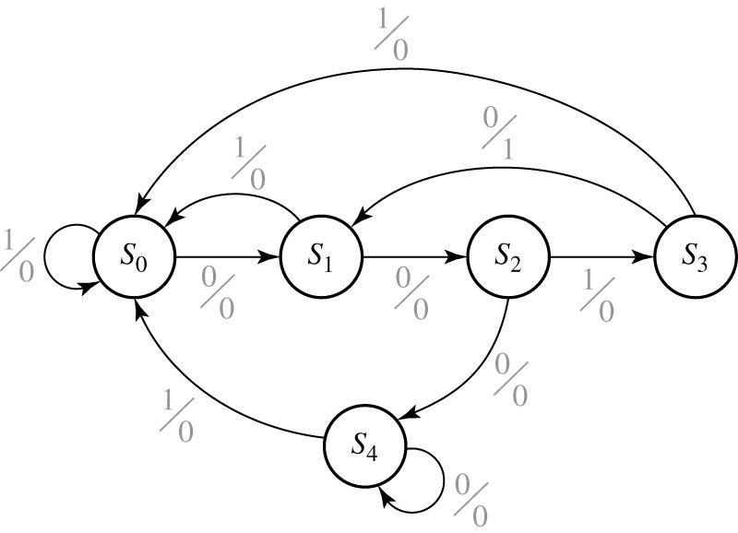
14. Programmed Exercises 14.1
Verify that this state graph gives the proper output sequences for the input sequences
listed t the start of this exercise.
Write down the Mealy state table which corresponds to the preceding graph.

Slide 44
14. Programmed Exercises 14.1
Answer
Present | Next | State | Output
State | 0 | 1 | 0 | 1
S₀ S₁ S₂ S₃ S₄ | S₀ S₁ S₂ S₃ S₄ | S₀ S₁ S₂ S₃ S₄ | 0 0 0 1 0 | 0 0 0 0 0

Slide 45
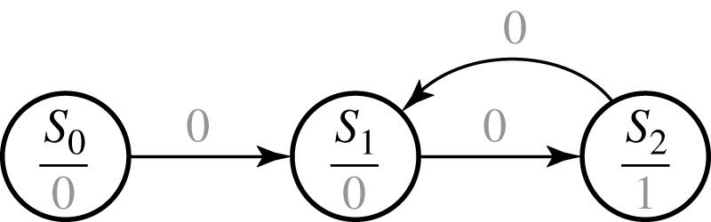
14. Programmed Exercises 14.2
State | Sequence received
S₀ S₁ S₂ S₃ S₄ | (reset) odd number of 0’s

Slide 46
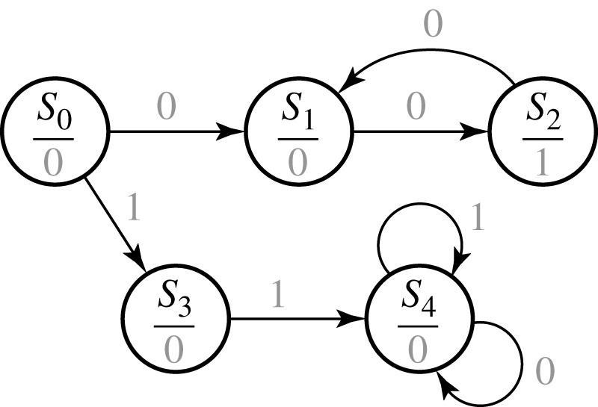
14. Programmed Exercises 14.2
State | Sequence received
S₀ S₁ S₂ S₃ S₄ S₅ S₆ | (reset) odd number of 0’s even number of 0’s 1 11 (followed by any sequence)

Slide 47
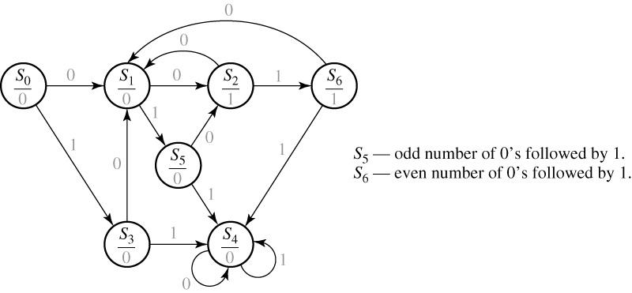
14. Programmed Exercises 14.2

Slide 48
14. Programmed Exercises 14.2
Answer
Present | Next | State | Output
State | 0 | 1
S₀ S₁ S₂ S₃ S₄ S₅ S₆ | S₁ S₂ S₁ S₁ S₄ S₂ S₁ | S₃ S₅ S₆ S₄ S₄ S₄ S₄ | 0 0 1 0 0 0 1

Slide 49
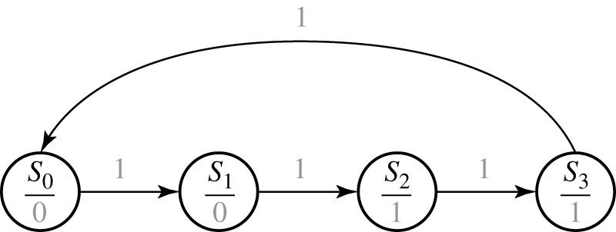
14. Programmed Exercises 14.3
Answer to (d)

Slide 50
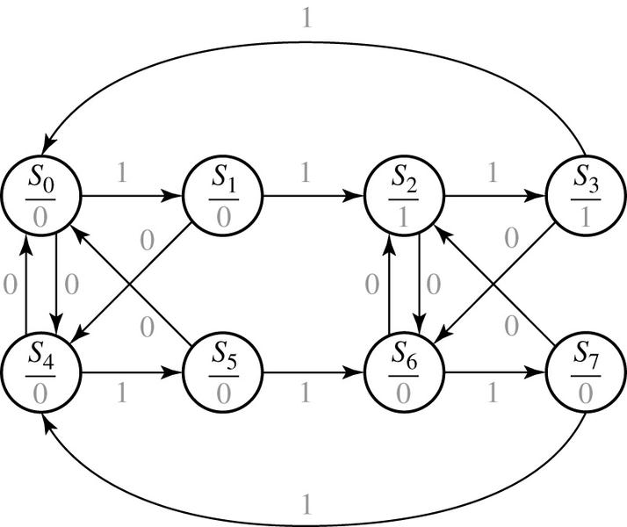
14. Programmed Exercises 14.3
Answer to (g)

